Slide 1
What’s “Shaking Out” in Disaster Preparedness and Response: Who to Call for Help
Tom Clareson
Senior Consultant for Digital & Preservation Services
LYRASIS
SAA Annual Conference
August 3, 2016

Slide 2
A Time of Transition
Heritage Preservation Offices closed 4/30/15
Heritage Preservation dissolved as Private Non-Profit (PNP) on 6/30/15 following member vote
Transition of programs to FAIC:
Connecting to Collections Care Online Community
Alliance for Response
State Heritage Emergency Partnership
Risk Evaluation and Planning Program
MayDay Campaign
Awards Programs
Digital Resources to FAIC CoOL for:
Save Outdoor Sculpture
Rescue Public Murals

Slide 3
National Heritage Responders
202-
661-
8068

Slide 4
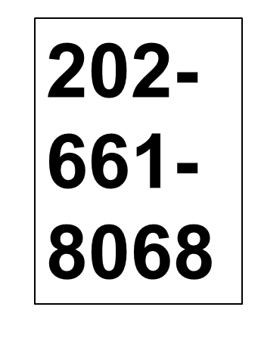
NHR Deployments

Slide 5
Existing and new AFR networks
Atlanta Boston Central Pennsylvania Central Virginia Dallas Denver Galveston-Houston Los Angeles Miami Minneapolis – St. Paul
New Jersey New York City NW Pennsylvania Ohio
Philadelphia Pittsburgh Portland Raleigh San Diego San Francisco Sacramento Savannah Seattle Utah Vermont Mississippi Gulf Coast Capital District New York
New Orleans (NOAR) in 2017

Slide 6
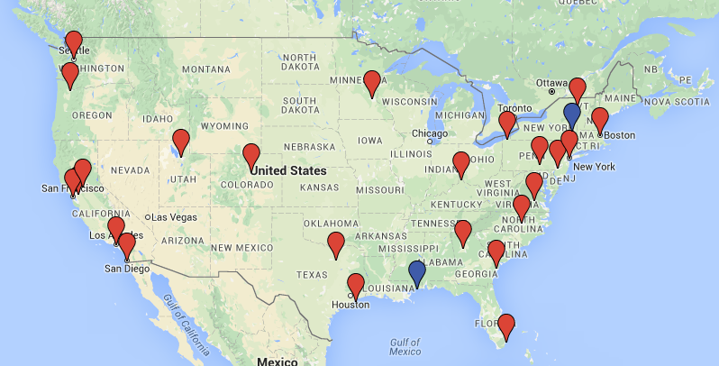

Slide 7
Pittsburgh Alliance for Response
Began in June 2008; initial Forum meeting had strong corporate and community support
Strong focus on education:
Tabletop exercises
Insurance, Mold Remediation presentations
Half-day workshop on Fire Protection Systems
Institutional site visits with survey report outcomes
Winterizing Your Collections discussion
Received NEH Preservation Assistance Grant to develop cooperative disaster supply cache
Regular elections for Chair and Committee Heads

Slide 8
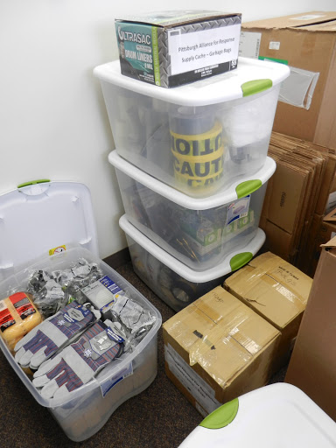
Pittsburgh AFR: Collaborative Use of PAG Funds

Slide 9
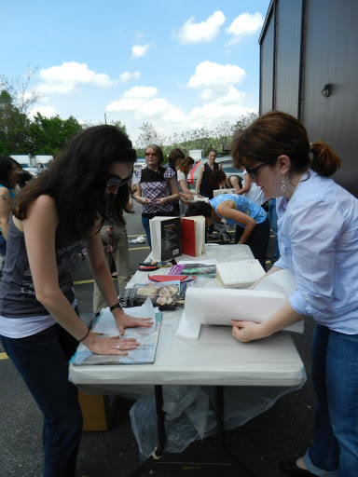
Pittsburgh AFR Disaster Recovery Workshop

Slide 10
AFR Website: www.heritageemergency.org/afr

Slide 11
Organized in 1995, the Task Force is a partnership of 42 national service organizations and federal agencies created to protect cultural heritage from natural disasters and other emergencies.
The Federal Emergency Management Agency (FEMA) co-sponsors the Task Force with the Smithsonian Institution.
Notes:
[read first sentence of slide]
For its first 20 years, the Task Force was co-sponsored by FEMA and the private nonprofit Heritage Preservation, which advocated for the protection of cultural heritage.
When HP was dissolved last year, the Smithsonian Institution, one of the founding members of the TF and a leader in the protection of cultural and historic resources – both at home and abroad – stepped up to fill the void left by HP’s departure.

Slide 12
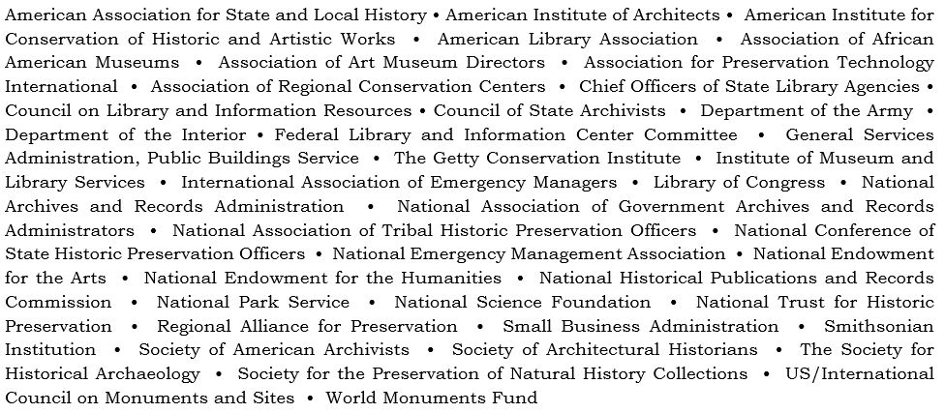

Slide 13
Task Force Objectives
Help cultural heritage institutions and sites prepare for emergencies and obtain needed resources when disaster strikes
Encourage the incorporation of cultural and historical resources into disaster planning and mitigation efforts at all levels of government
Facilitate a more effective and coordinated response to all kinds of emergencies, including catastrophic events
Assist the public in recovering treasured heirlooms damaged by disasters
Notes:
HENTF has 4 goals that can be framed in terms of preparedness, advocacy, coordination, and outreach.

Slide 14
A Grant to Assist in Planning
National Endowment for the Humanities – Preservation Assistance Grants
Up to $6,000 for preservation consulting, education, and supplies/equipment
Preservation Site Survey projects including Disaster Risk Assessments and Disaster Plan Development; Pittsburgh used funding for Disaster Cache
2017 Estimated Deadline: Early May
Information at www.neh.gov

Slide 15
MayDay: Do ONE Thing

Slide 16
Resources
Foundation of the American Institute for the Conservation of Historic and Artistic Works (AFR and NHR): http://www.conservation-us.org/emergencies -- Jessica Unger, junger@conservation-us.org, 202-661-8069
Heritage Emergency National Task Force: Lori Foley, Administrator, FEMA/Smithsonian, lori.foley@fema.dhs.gov, 202.826.6303
Regional Alliance for Preservation (RAP): http://www.rap-arcc.org/rap-members
CCAHA: 215.545.0613 or www.ccaha.org
LYRASIS: 800.999.8558 or www.lyrasis.org
NEDCC: 978.470.1010 or www.nedcc.org
Western States & Territories Preservation Assistance Service (WESTPAS): 888.905.7737 or www.westpas.org
Notes:
16

Slide 17
Questions and Feedback?
Contact Information:
Tom Clareson Senior Consultant for
Digital & Preservation Services 800.233.3401 or 614.439.1796 tom.clareson@lyrasis.org

